Slide 1

HAWAI’I
STATE GREENHOUSE GAS INVENTORY
LAUREN HART, CLAY MOSOLINO , LEXI TAYLOR
FALL 2024
ENGR 532
(Hawai’i Toursim Authority (a), n.d.)[Photo]

Slide 2

HAWAI’I & CLIMATE
BACKGROUND
First state to declare a climate emergency in 2022
Met previous goal of limiting GHG emissions below 1990 levels by 2020
4/5 of Hawai’i’s energy comes from fossil fuels - highest percentage of any state
Current goal (2022 Legislature):
Bring GHG emissions 50% below 2005 levels by 2030, and net-negative by 2045.
Not on track to meet these goals
(Act 238, 2022)
(State of Hawai’i Department of Health, n.d.
(Hawai’i Toursim Authority (b), n.d.) [Photo]
Notes:
Lexi

Slide 3

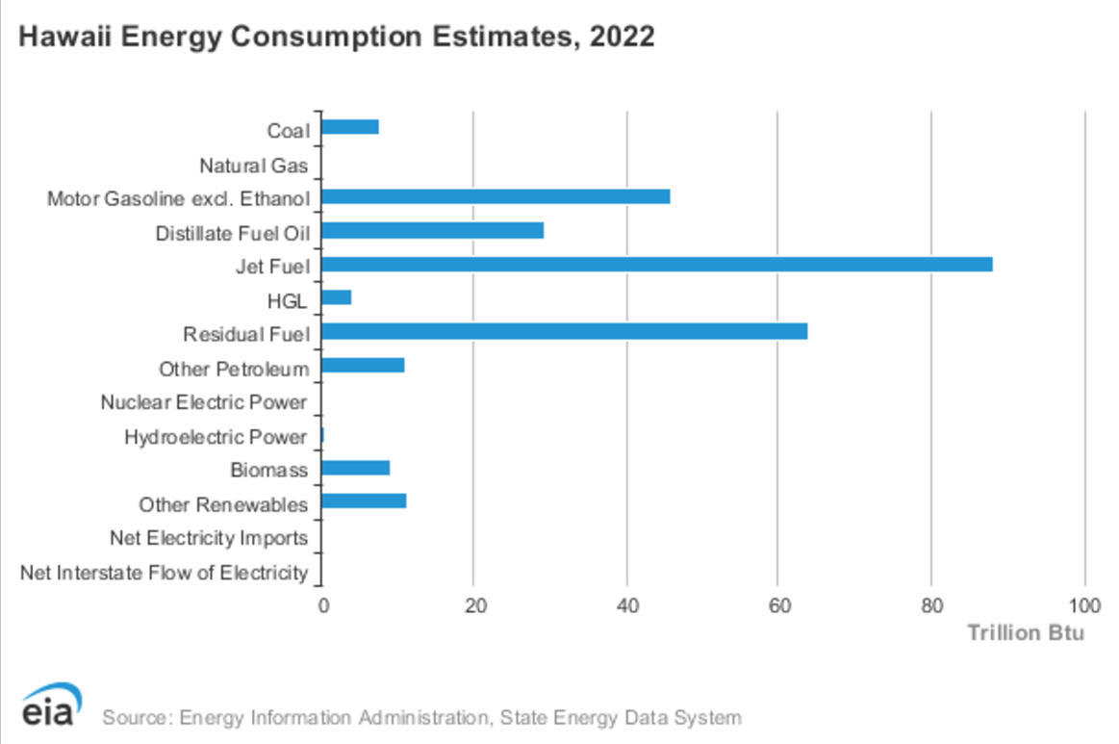
Notes:
Lexi

Slide 4
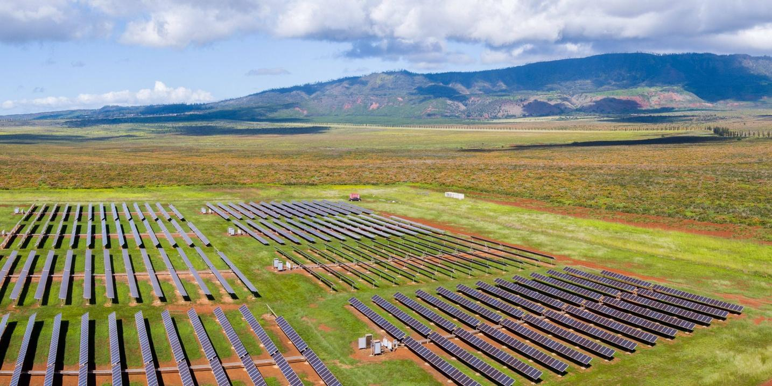
GHG INVENTORY
METHODS
Retrieve energy-use data for most recent complete year from the U.S. Energy Information Administration
electricity, transportation, and natural gas sectors separately analyzed
Multiply consumption volume by associated emissions factor sourced from the U.S. Environmental Protection Agency
convert to MMT for equivalent comparison
(Hawai’i State Energy Office (a), n.d.) [Photo]
Notes:
Lauren

Slide 5
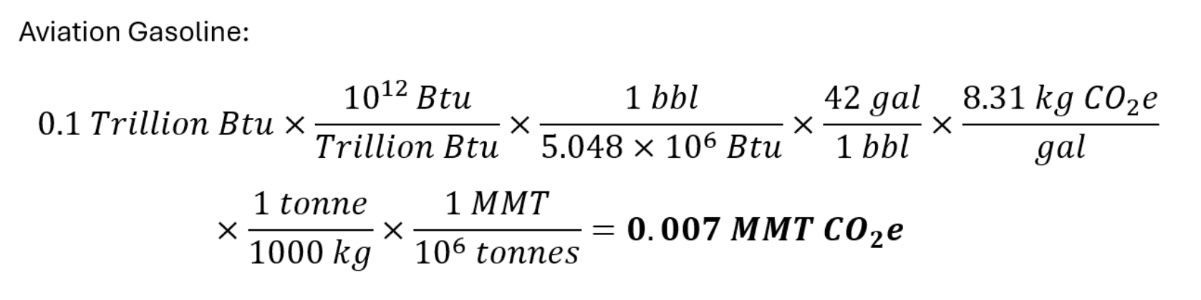
SAMPLE CALCULATION
METHODS
Notes:
Lauren

Slide 6
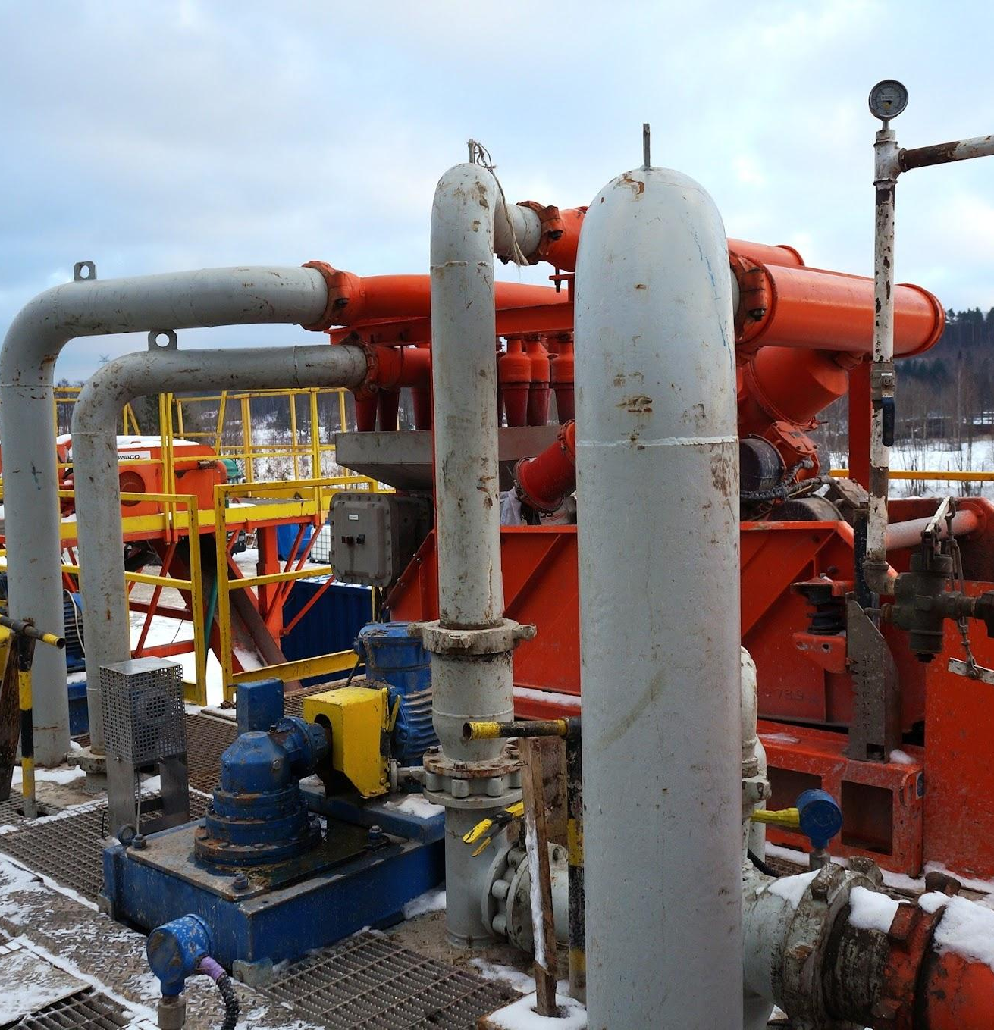
ENERGY SECTORS
NATURAL GAS
Hawaii does not produce any of its own natural gas.
Very little is used in Hawaii – In 2022 it used the least of all states at nearly 3 billion cubic feet
Consumption is equivalent to 163,000 metric tons of CO2e (113 kg per capita)
Notes:
Clay

Slide 7
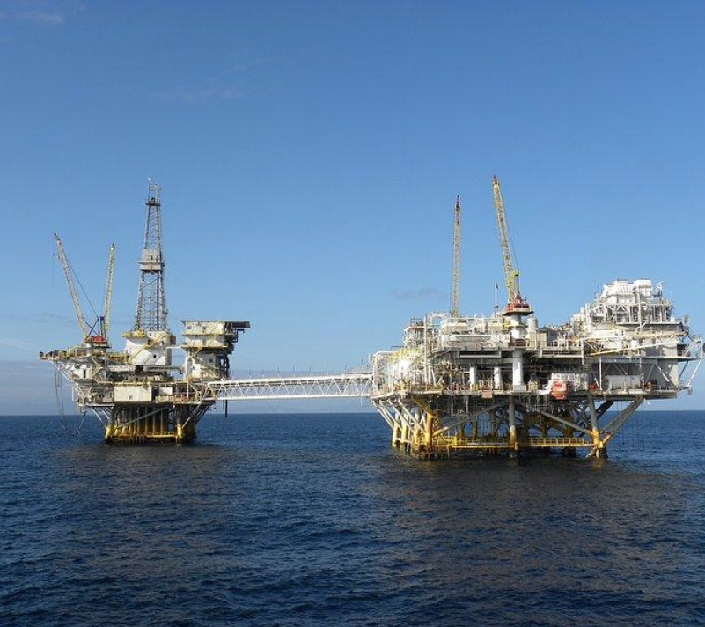
ENERGY SECTORS
ELECTRICITY
Electricity consumed in the state of Hawaii is generated by electric utilities and non-utility electricity producers, such as IPPs and CPPs
Consumers also generated some electricity from PV systems in residential and commercial uses, but for this analysis this will be treated as negligible
The major source of electricity generation comes from imported petroleum
Since 1990, the use of waste, coal, wind, and geothermal energy became more used in electricity generation
Notes:
Lexi
Independent Power Producer; Captive Power Plant

Slide 8
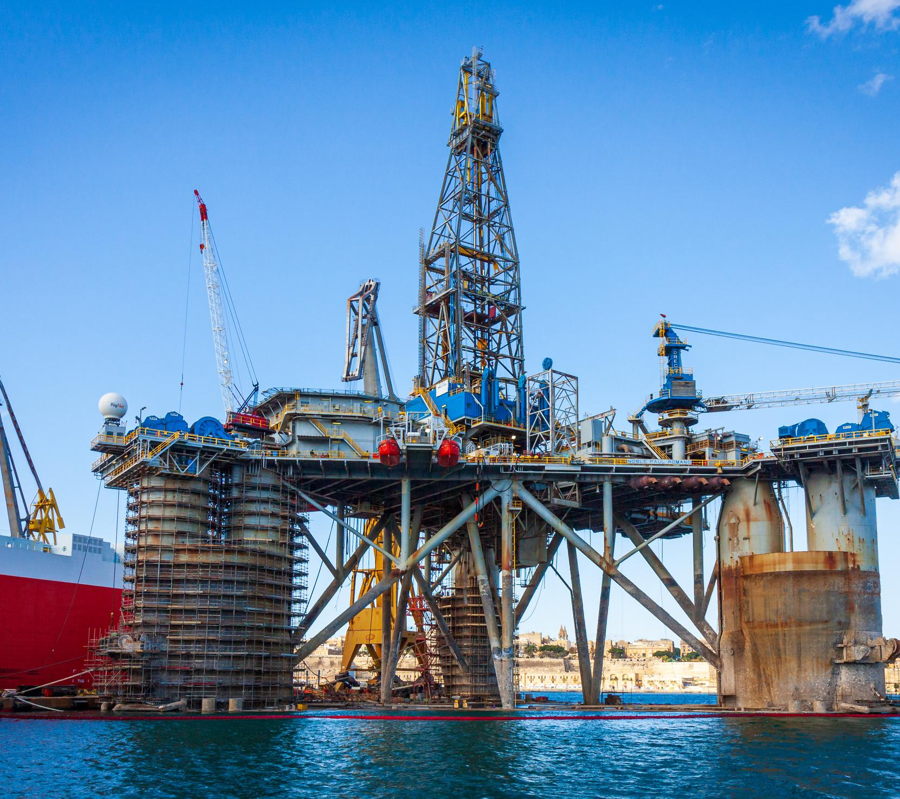
ENERGY SECTORS
ELECTRICITY ANALYSIS
In 2021, Hawaii consumed 8.9 million GWH of electricity
Majority of this at 67% was from petroleum
The state’s total carbon footprint for the year of 2021 was calculated as 3.8 million tCO2e
Notes:
Lexi

Slide 9
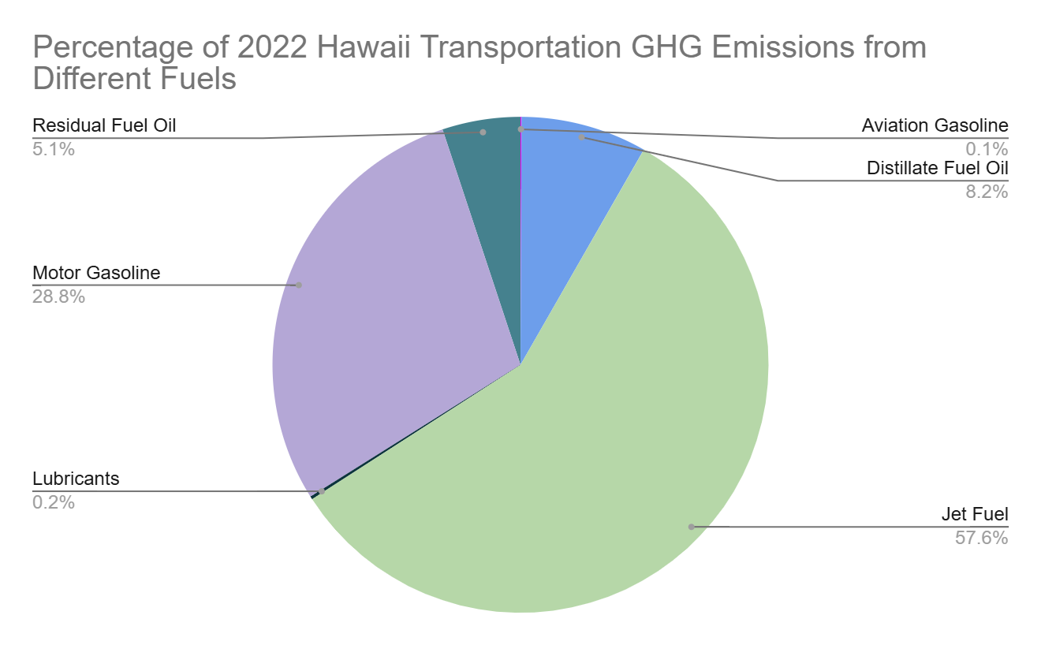
ENERGY SECTORS
TRANSPORTATION
2022 emissions:
11.388 MMT CO2e
Around 57% of energy consumption in Hawai’i and 74% of GHG emissions can be attributed to the transportation sector
Huge opportunity for improvement in GHG emissions
(Hawai’i State Energy Office (b), n.d.)
Notes:
Lauren
It was found that in 2022, Hawai’i’s transportation sector contributed to 11.388 MMT of CO2e emissions.
The transportation sector represents a very large portion of the energy consumption in Hawai’i, which means it also represents a significant opportunity for reductions in GHG emissions.

Slide 10

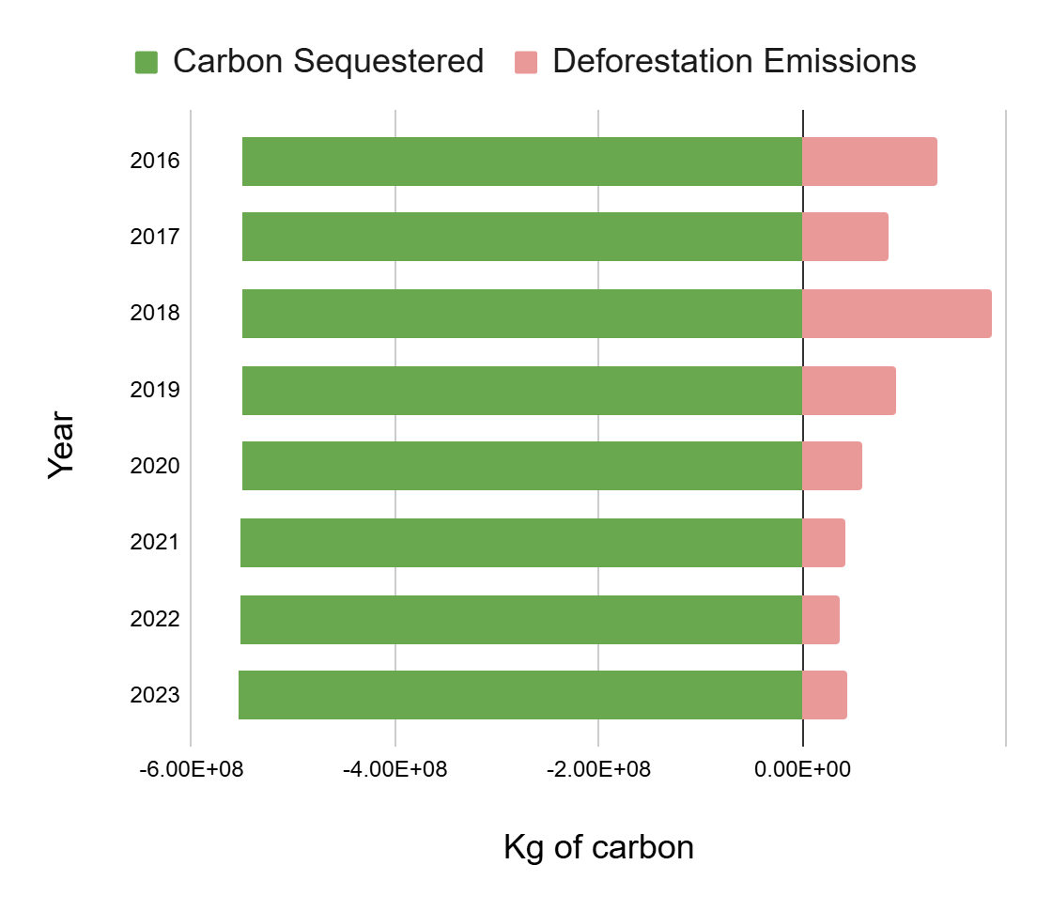
DIFFICULT TO ESTIMATE
FOREST LOSS
On Average
85.5 ktons Carbon emitted annually from forest loss
551 ktons Carbon sequestered annually
Hawaii’s forests are a net sink of 466 ktons Carbon annually
Notes:
Clay

Slide 11

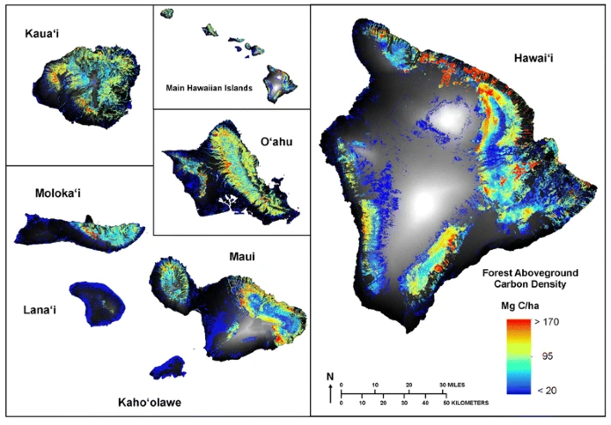
Methodology
Establish baseline above ground and below ground (soil) carbon density in Hawaii’s forests
Find annual forest lost
Estimate carbon emission factor for above ground and below ground based on different deforestation causes:
fire
non fire
Calculate carbon emitted from forest loss
Calculate carbon stored from carbon sequestration
Net Sink!
LEARN MORE
Figure above comes from Figure 2 in Asner (2016), showing the aboveground carbon density of Hawaii's forests.
Notes:
Clay

Slide 12
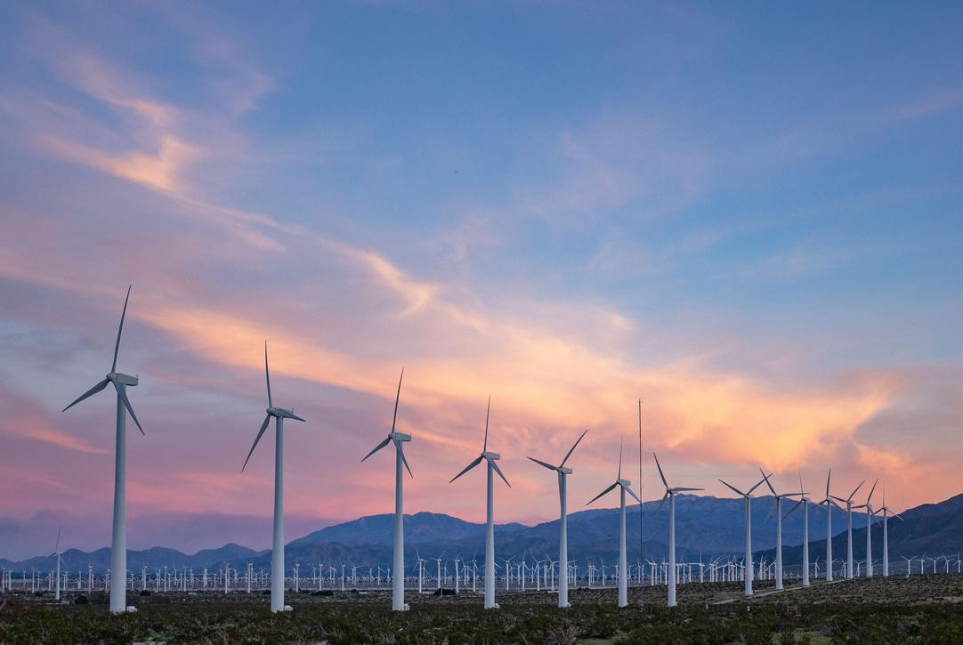

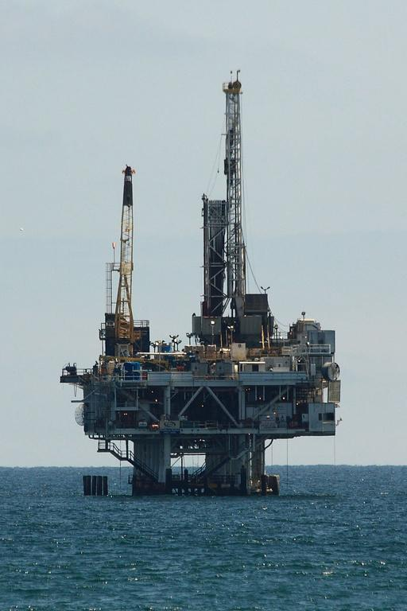
HAWAI’I GHG
FUTURE TRAJECTORIES
Business As Usual
Per capita GHG emissions remain the same for all sectors
Projected population growth sourced from Hawai’i Department of Business, Economic Development, and Tourism
15.95 MMT CO2 in 2030
16.39 MMT CO2 in 2040
16.59 MMT CO2 in 2050
Transforming the Grid
Hawai’i Clean Energy Initiative
100% renewable energy in electricity sector by 2045
Embedded Carbon in renewable energy infrastructure
Complete Reduction of “smokestack” electricity emissions in 20 years
No changes in natural gas use, EV penetration, or biofuels
4,060,000 MT reduction in CO2e
(Hawaii Depatment of Business, Economic Development, and Tourism, 2024)
Notes:
Lauren
The Research and Economic Analysis Division of Hawaii’s Dept of Business, Economic Development, and Tourism projects an increase in population to 1.56 million in 2050.
Using their projections for population growth and assuming that GHG emissions are proportional to population growth with no changes in behavior or policy, GHG emissions would continue to grow with the population.
Hawai’i has the goal of achieving 100% renewable energy in their electricity grid by 2045. If this could be achieved in a vacuum without altering any other variables, this would only result in a 4 million metric ton reduction in CO2 emissions per year by 2050. A 25% reduction from BAU
Other complementary strategies are necessary to reduce emissions even further
globally, 36.8 billion MTs on CO2e are emitted every year, according to the IEA. (IEA, 2023)

Slide 13

Even with the goal of a completely renewable grid by 2045, Hawai’i is a still a large consumer of fossil fuels.
Since transportation is the largest contributor to Hawaii's GHG emissions, a renewable electricity grid does not bring the state’s emissions as low as expected.
Policy needs to focus on reductions in aviation and maritime related emissions in addition to current work in renewable energy development.
HAWAI’I STATE GHG INVENTORY
CONCLUSION
(Hawai’i Tourism Authority (a), n.d.)[Photo]
Notes:
Lexi

Slide 14
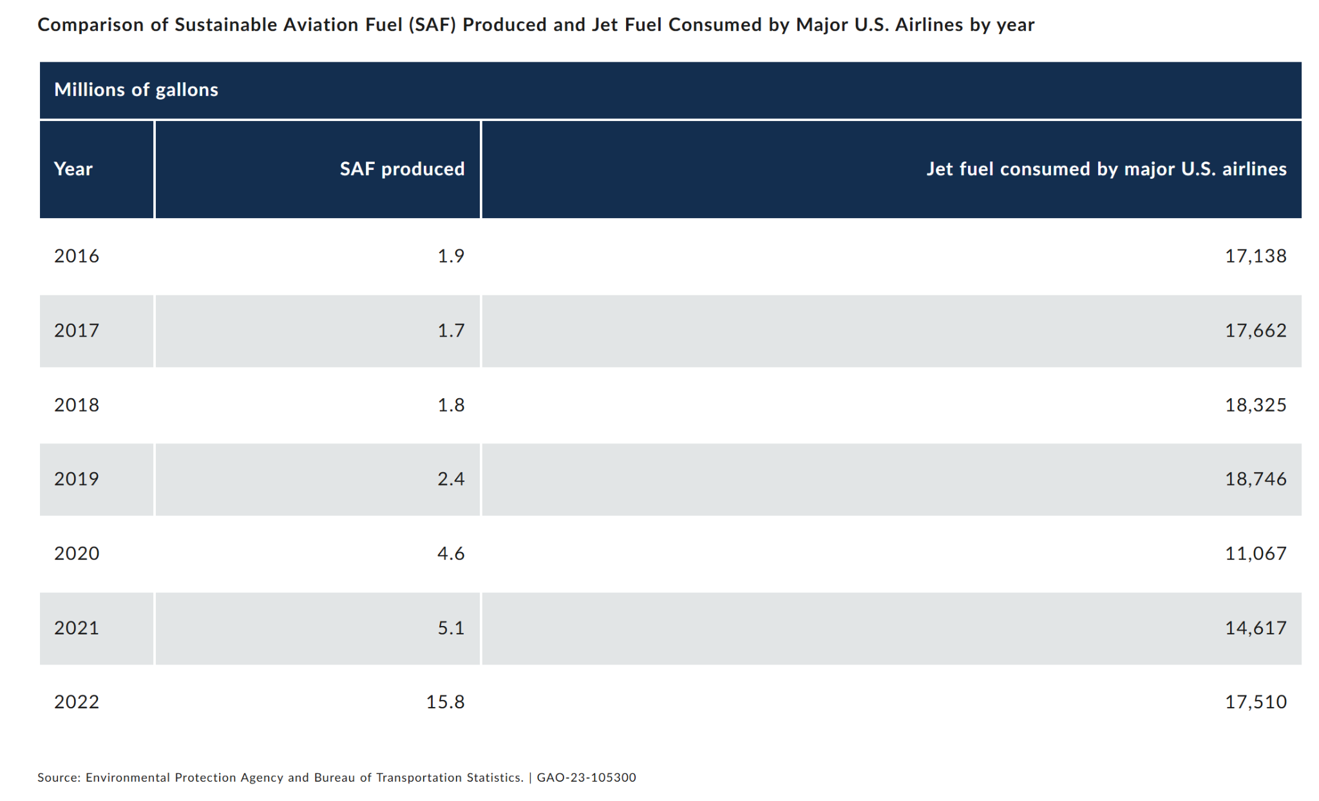
HAWAI’I STATE GHG INVENTORY
RECOMMENDATIONS
Funding R&D into solutions for sustainable aviation
Set a required percentage of SAF used by airlines flying to Hawai’i
Promote local development of infrastructure for production of SAF from waste feedstocks
(US Government Accountability Office, 2023)
Notes:
Hawai’i requires so much jet fuel because of the large military presence and the commercial airline industry;
Jet fuel accounts for 57% of transportation emissions and will be difficult to reduce emissions.

Slide 15
References
Act 238 – A bill for an Act Relating to Climate Mitigation, H.R. 1800, 2022 Legislature. (2022). chrome-extension://efaidnbmnnnibpcajpcglclefindmkaj/https://health.hawaii.gov/cab/files/2023/05/SLH2022_Act238.pdf
Hawai’i Department of Business, Economic Development, and Tourism. (2024). DBEDT 2050 series appendix tables. Table A-2 [Data set]. Research and Economic Analysis. https://dbedt.hawaii.gov/economic/economic-forecast/long-range-projections/
Hawai’i State Energy Office (a) (n.d.). https://energy.hawaii.gov/what-we-do/energy-landscape/
Hawai’i State Energy Office (b) (n.d.) Transportation. https://energy.hawaii.gov/what-we-do/clean-energy-vision/transportation/#/analyze?fuel=ELEC&country=US®ion=US-HI&show_map=true
Hawaii State Government. (2022, December 22). 2022 state population estimates. Department of Business, Economic Development & Tourism: Census. https://census.hawaii.gov/main/2022-state-pe/
Hawai’i Tourism Authority (a). (n.d.). https://www.gohawaii.com/
Hawai’i Tourism Authority (b). (n.d.). https://www.gohawaii.com/malama
International Energy Agency. (2023) Global CO2 emissions rose less than initially feared in 2022 as clean energy growth offset much of the impact of greater coal and oil use. https://www.iea.org/news/global-co2-emissions-rose-less-than-initially-feared-in-2022-as-clean-energy-growth-offset-much-of-the-impact-of-greater-coal-and-oil-use
Prussi, M., Lee, U., Wang, M., Malina, R., Valin, H., Taheripour, F., ... & Hileman, J. I. (2021). CORSIA: The first internationally adopted approach to calculate life-cycle GHG emissions for aviation fuels. Renewable and Sustainable Energy Reviews, 150, 111398.
nhouse%20gas,jet%20fuel%20demand%20by%202050.

Slide 16
References Cont.
State of Hawaii Department of Health Clean Air Branch. (n.d.). Hawaii Greenhouse Gas Program. https://health.hawaii.gov/cab/hawaii-greenhouse-gas-program/#:~:text=The%20statewide%20GHG%20emission%20limit,and%204.61%20MMT%20CO2%20Eq.
U.S. Department of Energy (b). (n.d.). Sustainable Aviation Fuel. Alternative Fuels Data Center. https://afdc.energy.gov/fuels/sustainable-aviation-fuel#:~:text=Sustainable%20aviation%20fuel%20(SAF)%20is,how%20the%20fuel%20is%20produced.
U.S. Department of Energy (a) (n.d.). Transportation Fuels. https://www.energy.gov/energysaver/transportation-fuels
U.S. Energy Information Administration (EIA). (n.d.). Energy-Related CO2 Emission Data Tables. U.S. Energy Information Administration (EIA). https://www.eia.gov/environment/emissions/state/
U.S. Energy Information Administration. (2024, October 31). Hawaii Natural Gas Summary. https://www.eia.gov/dnav/ng/ng_sum_lsum_dcu_SHI_m.htm
U.S. Environmental Protection Agency (EPA). (2024, February 22). GHG Emission Factors Hub. EPA. https://www.epa.gov/climateleadership/ghg-emission-factors-hub
US Government Accountability Office. (2023). Sustainable Aviation Fuel. https://www.gao.gov/products/gao-23-105300#:~:text=To%20reduce%20aviation%20greenhouse%20gas,jet%20fuel%20demand%20by%202050.

Slide 17
References Cont. - Forest Loss Emissions
Asner, G. S. (2016). Rapid forest carbon assessments of oceanic islands: a case study of the Hawaiian archipelago. Carbon Balance Manage. doi:https://doi.org/10.1186/s13021-015-0043-4
Brown, S., Sathaye, J., Cannell, M., Kauppi, P.E. (1996). Mitigation of carbon emissions to the atmosphere by forest management. Commonwealth Forestry Review. 75(1)
Crow, S. M. (2016). Carbon balance implications of land use change from pasture to managed eucalyptus forest in Hawaii. Carbon Management. doi:10.1080/17583004.2016.1213140
Global Forest Watch. (2024). Hawaii Forest Change 2023. Retrieved from Global Forest Watch: https://www.globalforestwatch.org/dashboards/country/USA/12/?category=land-cover&location=WyJjb3VudHJ5IiwiVVNBIiwiMTIiXQ%3D%3D
Mgelwa, A. S. (2024). Meta-analysis of 21st century studies shows that deforestation induces profound changes in soil characteristics, particularly soil organic carbon accumulation. Forest Ecosystems.
Osher, L. M. (2003). Effect of land use change on soil carbon in Hawaii. Biogeochemistry, 65, 213-232. doi:https://doi.org/10.1023/A:1026048612540
Selmants, P. C. (2014). Ecosystem carbon storage does not vary with mean annual temperature in Hawaiian tropical montane wet forests. Global Change Biology, 20(9), 2927-2937.
USAID Asia, Lowering Emissions in Asia’s Forests. (n.d.). Module EF-D: Emission Factors for Deforestation. LEAF TECHNICAL GUIDANCE SERIES FOR THE DEVELOPMENT OF A NATIONAL OR SUBNATIONAL FOREST MONITORING SYSTEM FOR REDD+.

Slide 18
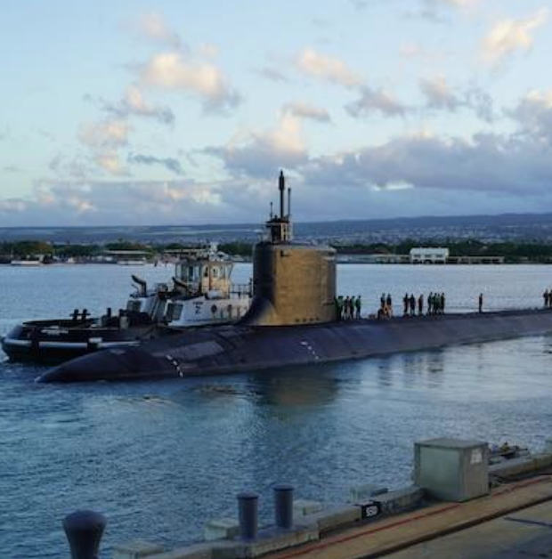
Fuel Type | Use
Distillate Fuels | Trucks Buses Trains Boats Ships
Jet Fuel | Jet airplanes Helicopters
Residual Fuel Oil | Ships
Aviation Gasoline | Aviation
Lubricants | Reduction of friction in engines
Motor Gasoline | Cars SUVS Light trucks Motorcycles Recreational vehicles and boats
APPENDIX A
TRANSPORTATION FUEL TYPES & USES
(DOE, n.d.)

Slide 19

APPENDIX B
SUSTAINABLE AVIATION FUEL (SAF)
An SAF blend with Jet A can be used in existing aircrafts
No additional costs to bring new aircrafts into service
Could be implemented immediately
Potential to reduce emissions by up to 94% (Prussi et al., 2021)
Feedstock can be very broad, including sugar cane and municipal solid waste (food waste and yard waste)
Notes:
Lauren
The Research and Economic Analysis Division of Hawaii’s Dept of Business, Economic Development, and Tourism projects an increase in population to 1.56 million in 2050.
Using their projections for population growth and assuming that GHG emissions are proportional to population growth with no changes in behavior or policy, GHG emissions would continue to grow with the population.
Hawai’i has the goal of achieving 100% renewable energy in their electricity grid by 2045. If this could be achieved in a vacuum without altering any other variables, this would only result in a 4 million metric ton reduction in CO2 emissions per year by 2050. A 25% reduction from BAU
Other complementary strategies are necessary to reduce emissions even further
globally, 36.8 billion MTs on CO2e are emitted every year, according to the IEA. (IEA, 2023)

Slide 20
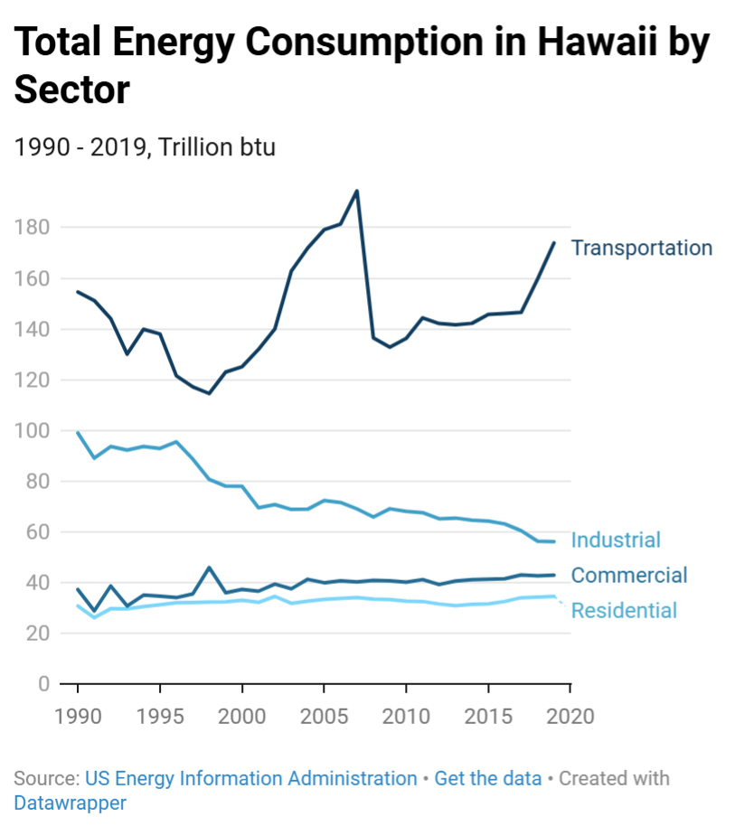

Slide 21
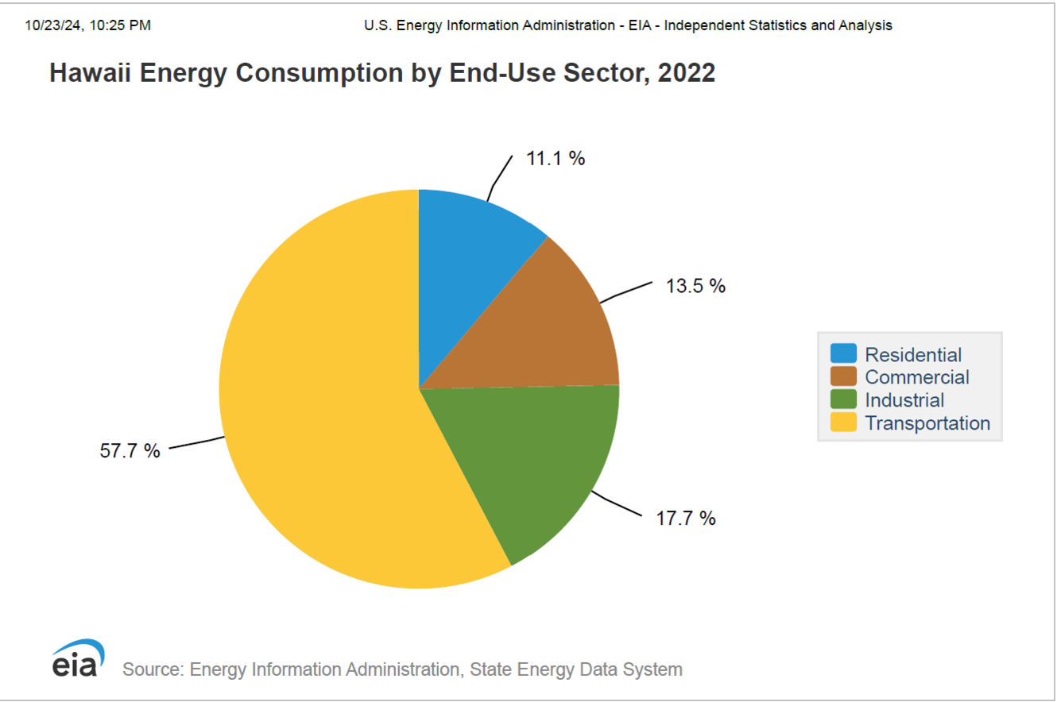


Slide 22
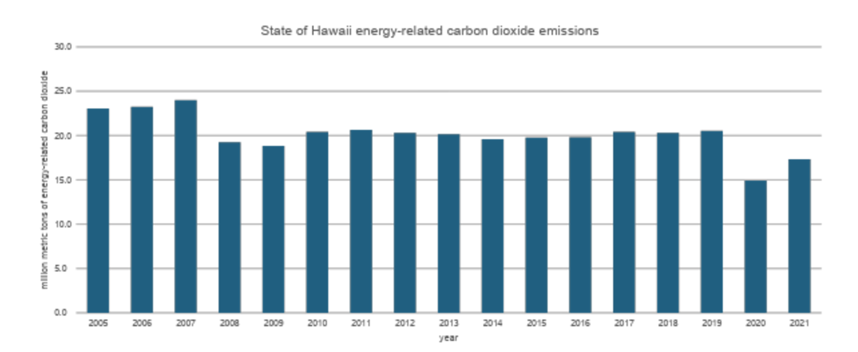
Past Annual Emissions (MMT CO2)
(EIA, n.d.) [Figure]
(Hawai’i Toursim Authority (a), n.d.)[Photo]

Slide 23
extra slides >>>

Slide 24




Rimberio Co
SAVE ENVIRONTMENT
MEET OUR VOLUNTEER
Adeline Palmerston
Connor Hamilton
Brigitte Schwartz
Conservation Volunteer
Conservation Volunteer
Conservation Volunteer
Presentation Design

Slide 25





SAVE ENVIRONTMENT
OUR CONTACT
hello@reallygreatsite.com
www.reallygreatsite.com
123 Anywhere ST., Any City, ST 12345
+123-456-7890
Presentation Design

